Slide 1
Big Mountain Resort Assessment
Marcello Federico

Slide 2
PROBLEM Identification
Ticket Price
Big Mountain Resort is undercharging for their admission price and need a way to determine how much they should increase the price.
Adding features
Keeping the features added to the resort relevant to how much other resorts have.
Costs
Are the costs worth it? Does paying for additional features justify higher ticket prices to customers?

Slide 3
Recommendations
Adding a chairlift, 150ft of vertical drop, and another run
Consider adding a tram
Big Mountain Resort is fairly large but doesn’t have a tram for the premises. If a tram was added, it could justify a higher price increase for tickets.
These features would add a projected $3,474,638 to the annual revenue, assuming 350,000 guests attend that year.

Slide 4
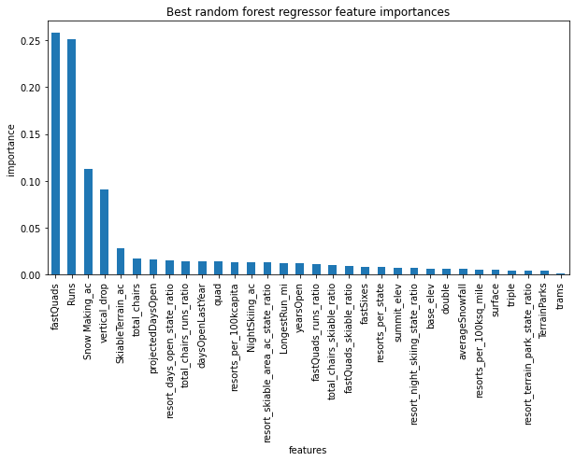
Modeling and analysis

Slide 5
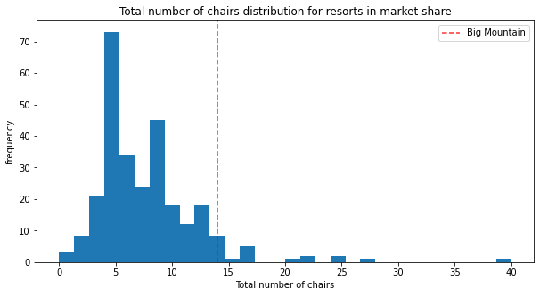
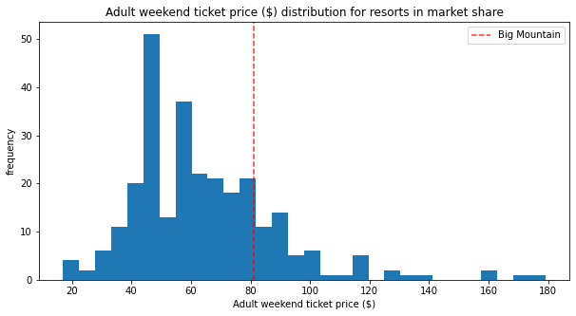
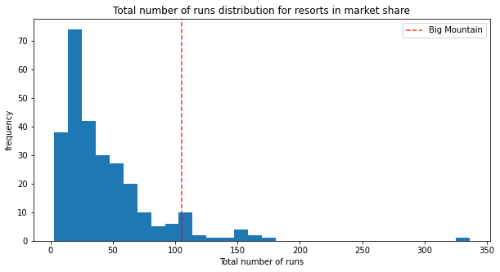
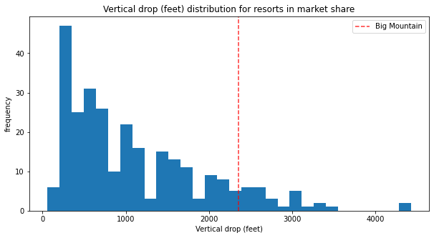
COMPARISON OF FEATURES BETWEEN RESORTS

Slide 6
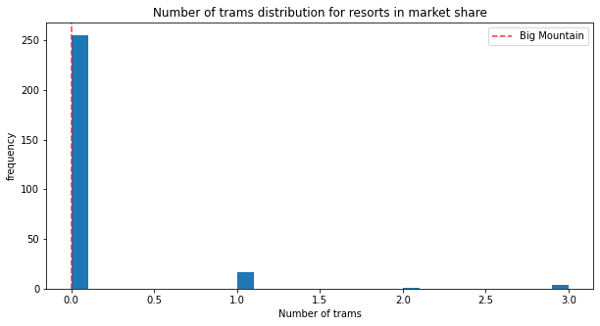
considerations

Slide 7
Conclusion
Big Mountain Resort has some of the most attractions compared to other resorts. If a chairlift, 150ft of vertical drop, and another run were added, there would be over $3,000,000 in added revenue and could reasonably increase their ticket price to about $96 to reflect these additional features.

